Slide 1

Gender Issues in Housing
JUDITH FOX
NOTRE DAME LAW CLINIC

Slide 2
What will we cover today?
Fair Housing Act
HUD Regulations
The housing wealth gap
Domestic Violence Issues

Slide 3
Fair Housing Act
1968
42 USC §3601 et. seq.
Scope: sales, rental or financing of housing
Protected classes:
race,
religion,
national origin
sex
handicap (added later)
and family status (added later)

Slide 4
Indiana Fair Housing Act
Provides “rights and remedies substantially equivalent to those granted under federal law” Ind. Code §22-9.5-1-1(3)
Ind. Code § 22-9.5-1 et. Seq.

Slide 5
Intimidation or Interference
Class A Misdemeanor:
  Intentionally intimidate or infer with
  Attempt to intimidate or interfer with
  Any aspect of buying, selling, renting etc. housing
Ind. Code §22-9.5-10-1

Slide 6
Article 9: South Bend Human Rights Ordinance
Cannot discriminate in housing based on “race, religion, color, sex, disability, national origin, ancestry, sexual orientation or gender identity, or familiar status”
“The promotion of equal opportunity without regard to race, religion, color, sex, disabiltiy, national origin, ancestry, sexual orientation or gender identity, or familial status in the case of housing, through reasonable methods is the purpose of this Article.”

Slide 7
What is discrimination based on “sex”
Title VII’s prohibition on discrimination “because of ….sex” covers discrimination on the basis of gender identity and sexual orientation,
a person who “discriminates against homosexual or transgender employees necessarily and intentionally applies sex-based rule”
Bostock v. Clayton County, 140 S.Ct. 1731, 1734(2020)

Slide 8
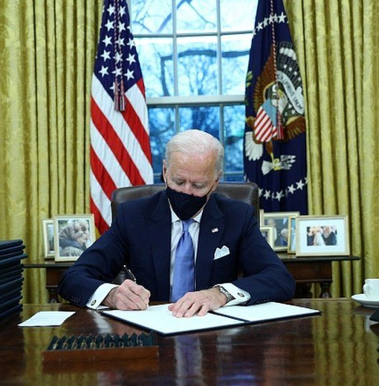
Executive Order on Preventing and Combating Discrimination on the Basis of Gender Identity or Sexual Orientation
January 20,2021

Slide 9
Covered statutes
Title IX of the Education Amendments of 1972
The Fair Housing Act
Section 412 of the Immigration and Nationality Act
Title VII of the Civil Rights Act

Slide 10
Scope of the order
Review all existing orders, regulations, guidance documents, policies, programs and other agency actions
  Promulgated or administered relating to agency’s compliance relating to sex discrimination
  Consider whether need to revise
  Whether additional actions are neded
  Within 100 days (April 30, 2021) develop a plan to carry this out

Slide 11
Fair Housing Act

Slide 12
Non-conformity discrimination
A transgender woman is asked by the owner of her apartment building not to dress in women’s clothing in the common areas of the property

Slide 13
Sexual Harassment and the Fair Housing Act
Quid Pro Quo and Hostile Environment Harassment and Liability for Discriminatory Housing Practices Under the Fair Housing Act 24 CFR Part 100.600

Slide 14
Hostile Environment
24 CFR 100.600(a)(2)
Unwelcome conduct
Sufficiently severe or pervasive
Interfere with :
  the availability, sale, rental or use and enjoyment of the property
  Terms, conditions or priviliges of the sale or rental
  Provisions or enjoyment of services or facilities
  Availability, terms or conditions of a residential real estate-related transaction
Does not require change in the economic benefits, terms or conditions

Slide 15
100.600(a)(2)(i)(A)
Nature of the conduct duration
Context location
Severity relationship of the parties
Scope
frequency

Slide 16
100.600(a)(2)(i)(B)
Need neither physical or psychological harm
Reasonable person perspective
One unwelcome act is enough if it is severe enough

Slide 17
Elements of Hostile Housing Environment
1) member of protected class
2) tenant subject to unwanted sexual advances, favors or other sexual conduct
3) based on the sex of the tenant
4) severe or pervasive
West v. DJ Mortgage, LLC, 164 F. Supp.3d. 1393, 1398 (N.D. Georgia, 2016)

Slide 18
Quid Pro Quo
100.600(a)(1)
Unwelcome request or demand to engage in conduct where submission to the request or demand
Explicitly or implicitly
Condition
  the availability, sale, rental or use and enjoyment of the property
  Terms, conditions or priviliges of the sale or rental
  Provisions or enjoyment of services or facilities
  Availability, terms or conditions of a residential real estate-related transaction
Can be violation whether or not you acquiesce

Slide 19
Harassement by other Tenants actionable
Violation when a “landlord that has actual notice of tenant-on-tenant harassment based on a protected status, yet chooses not to take any reasonable steps within its control to stop the harassment”
  Wetzel v. Glen St. Andrews Living Community, LLC, 901 F.3d. 856, 859 (7th Cir. 2018)

Slide 20
Retaliation claims
(1) engaged in protected activity
(2) suffered an adverse action
(3) causal connection between the two
No animus required
Notes:
In this case the tenant complained that she was being harassed by another tenant because she was gay; she alleged that once she complained, the management restricted her access to facilities and common spaces, downgraded her dining seat, halted her cleaning service and began building a case for eviction

Slide 21
2013 study of senior housing
Discrimination was a significant barrier for older LGB individuals seeking housing
48% of tests found the LGB tester experienced some form of discrimination
Opening Doors: An Investigation of Barriers to Senior Housing for Same-Sex Couples, Equal Rights Center (2014).

Slide 22
HUD equal Access Rule
Requires equal access to HUD programs without regard to a person’s actual or perceived sexual orientation, gender identity, or marital status

Slide 23
Feb. 11, 2020 Memorandum
Effective immediately, FHEO shall accept for filing and investigate all complaints of sex discrimination, including discrimination because of gender identity or sexual orientation

Slide 24
Domestic Violence Issues

Slide 25
Statutory coverage
Domestic violence or family violence
Stalking
Sex offenses
32-31-9-3

Slide 26
Early Lease termination
Written notice to landlord
Copy of the protection or no contact order
Safety plan by accredited domestic violence or sexual assault program
  Not more than 30 days old
  that recommends relocation
Owe rent up to time you leave, but not beyond
32-31-9-12

Slide 27
Retaliation
Cannot terminate, refuse to renew or refuse to enter into lease because
  Victim or alleged victim
  Protective order or no contact order
  Terminated lease previously under this statute

Slide 28
When perpetrator NOT a tenant
Landlord “shall change the locks” upon written request of the tenant not later than forty-eight hours after tenant gives landlord a copy of the protective order or no contact order
Ind Code §32-31-9-10

Slide 29
When the perpetrator IS a tenant
Landlord must change the locks within 24 hours of receiving the court order
Landlord is immune from liability for the lock-out
Person excluded remains liable for the rent
Ind. Code §32-31-9-10

Slide 30
Housing Wealth Gap
Housing represents dominant form of savings
Single men earn 1.5% higher unlevered returns than single women
After adjusting for mortgages, the number grows to 7.9%
This explains 30% of the gender gap in retirement wealth

Slide 31
Negotiation studies
There is a gender bias in negotiations
Men will require higher minimum bids if they know the buyer is female
Women tend to offer more money if the seller is male
Both men and women expect women to be more willing to share the surplus (pay more or get paid less)
Both men and women are more willing to walk away from an aggressive negotiation if the other party is female

Slide 32
Baltimore Eviction Map
46% more female headed households evicted than male headed households
Black women evicted 3.9 times more than white women
Tim Thomas, Ian Kennedy, Alex Ramiller, Ott Toomet & Jose Hernandez
May 8, 2020 https://evictions.study/maryland/report/baltimore.html

Slide 33
Racial and Gender Disparities among Evicted Americans
Study across 39 states
Average black female renter had an eviction rate of 6.4% (twice that of white female)
Overall eviction rate 2% higher for women than men
Peter Hepburn, Renee Louis, Matthew Desmond
Sociological Science 7: 649-662 (2020)

