Slide 1


Land contracts:
THE MESS THE FORECLOSURE CRISIS LEFT BEHIND
Judith Fox, Notre Dame Law School
Notes:
The previous speakers provided a picture of the housing crisis currently facing Americans and the consequences of that crisis. I am going to bring the story closer to home to talk about some specific housing challenges faced by Indiana.

Slide 2

Vacant and Abandoned housing
Increased nearly 50% in Indiana from 2000-2010
Decreasing, but still above 2005 levels
Notes:
To start: I need to provide a little history. The foreclosure crisis caused many homes in Indiana to become vacant and abandoned housing.
From 2000-2010, the number of vacant and abandoned properties in Indiana increased by nearly 50%.
While that number is currently decreasing, it is still above 2005 levels
Specific numbers are often hard to obtain. Cities seem reluctant to publish the numbers and small and rural communities do not typically have the resources to even count. However, I was able to piece together some numbers:
As of Nov 8, Indianapolis reported 7,244 abandoned properties. News reports claim Gary may have as many as 13,00 abandoned properties.

Slide 3
Bank Walkaways, abandoned Foreclosures
Indiana had a high number of bank walkaways: situations where the bank:
Started and abandoned the foreclosure
Never started the foreclosure
Foreclosed and “un-foreclosed”
Notes:
One of the reasons Indiana has so many abandoned properties is that it, during the foreclosure crisis, it was the location of many abandoned foreclosures. These are foreclosures that banks started and did not finish, finished—as in obtained judgments—but never took the properties to sale, or finished and then, incredibly “un-foreclosed.”
In 2010 the Government Accounting Office did a study of bank walkaways. Both Indianapolis and Fort Wayne placed in the top 20. In a footnote, the report mentions South Bend/Mishawaka. If you look at percent of housing as opposed to numbers of abandoned properties, South Bend/Mishawaka would also have placed in the top 20.
-
Un-forclosing on a property was something we had never seen before. I did a research project looking at all the foreclosures filed in 2011 in St. Joseph County andd Elkhart Counties found that 10% were abandoned or un-foreclosed by the lenders

Slide 4
Distressed Asset Sales
2010
HUD Pilot Program to sell non-performing loans
2012
HUD announced DASP (Distressed Asset Stabilization Program)
2014
Freddie Mac
2015
All three
Notes:
The reason many foreclosures were abandoned by their lenders was that the lenders already had too many properties, known as REOs (real estate owned) on their books. The government agencies that insured those loans, had too many nonperforming loans. Beginning with HUD, the three main insurers (HUD, Fannie Mae and Freddie Mac) created programs to sell these non-performing loans. They bundled up the loans, often by geographic areas, and sold them in auctions.
Originally, the purpose of these sales –or at least the stated purpose—was to sell the loans to entities not bound by governmental rules so that those buyers could work with the homeowners to avoid foreclosure. That did not happen and the GSEs soon abandoned the pretext.
What did happen was that the loans were originally bought by investors, largely hedge-funds. These buyers foreclosed quickly and then set out to either rent or sell the homes. This is where the plan went wrong. Most of these properties were in deplorable condition. There is evidence that many of the reverse foreclosures (those that were foreclosed and un-foreclosed) were un-foreclosed to allow the lender to include the loans in these sales. Several lenders made that argument in cases in St. Joseph County. I contacted HUD. It promised to comment, but never did.

Slide 5
Land Contract Post –Recession https://www.realtytrac.com/news/contract-for-deed-data-exclusive-analysis./
2005-2009
2010-2014
93,473 (RECORDED)
$141,423 AVERAGE PRICE
7.15% AVERAGE INTERESTR ATE
103,307 (RECORDED)
$87,010 AVERAGE PRICE
6.17% AVERAGE INTEREST RATE

Slide 6
Some “Hot-Spots”
Wayne County, MI (Detroit)
Genesee County, MI (Flint)
Trumbull County, OH (Youngstown)
Marion County, IN (Indianapolis)
St. Joseph County, IN (South Bend)

Slide 7
Recorded Land Contracts
2005-2016
Notes:
Harvard six state study: Michigan, Indiana, Ohio, Iowa, Minnesota, Wisconsin

Slide 8
Contract for Deed by value

Slide 9
The disappearing small Loan
Properties under $50,000
Mortgages

Slide 10

Land Contracts
Don’t be fooled by the name:
look to the terms of the contract
This Photo by Unknown Author is licensed under CC BY-SA-NC

Slide 11
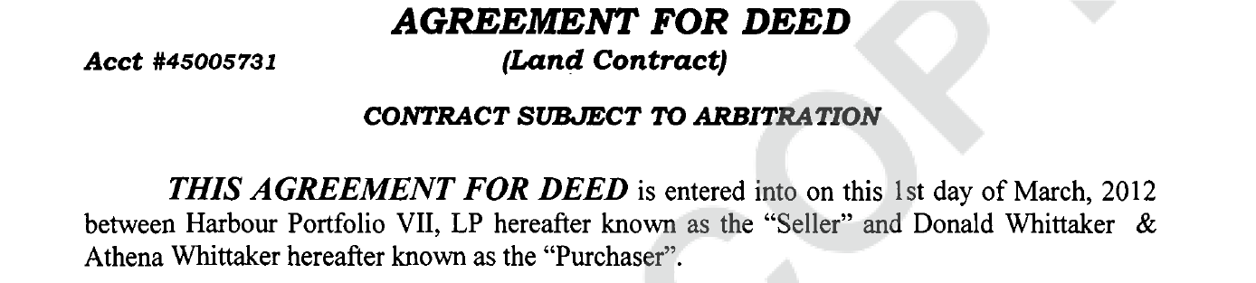
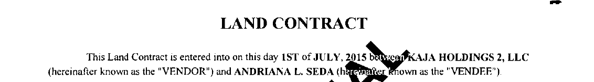
What’s a Land Contract?
Notes:
A land contract is an alternative way of financing a home wherein the seller retains title until all payments have been made. Unlike a traditional mortgage, the buyer does not typically earn any equity in the property prior to completing the contract. Land contracts go by numerous names across the county. Sometimes, this is because of state-law conventions. Often, however, it is an attempt to circumvent legal protections established for buyers.
Regardless of the name stamped on the top of a contract, if the contract is structured so that you are buying the property with installments over a number of years, it is a land contract.
In addition, people intent on evading legal protections tried to re-characterize the purchase as either a lease-option or a rent-to-own, where you rent for a specified period after which the contract reverts to a land contract.

Slide 12
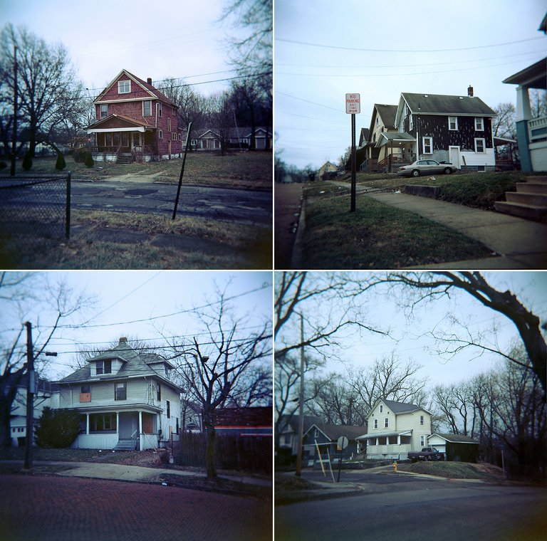
Some of the big players
Harbour Portfolio
Venture Capital
Kaja
Equity Point
Rainbow Realty
Notes:
Loan Star Funds, Bayview Asset Management and Selene Residential purchased the majority of the notes, but it was the practices of Harbour Portfolio that brought attention to this program. Harbour Portfolio, along with these other active players found that the properties were too damaged to either sell or rent. Instead, they returned to an old, predatory product, the land contracts.

Slide 13
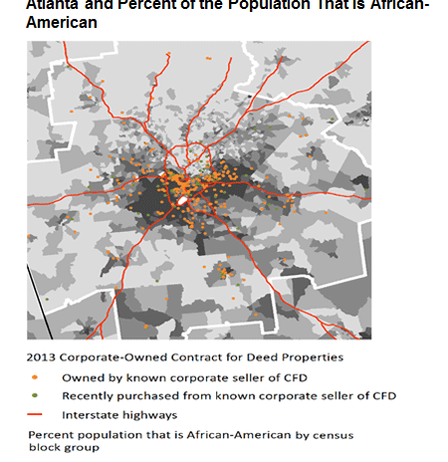
LAND CONTRACTS AND
FAIR HOUSING ISSUE

Slide 14

What’s old is new again: the resurgence of contract buying
Notes:
Land contracts are not new. In fact, they were significant in the creation of the Fair Housing Act. Beryl Sater brought attention to the product in her book, Family Properties, that discusses the use of land contracts in the 1950s and 60s (or contract buying as it was called in Chicago) to take advantage of minority borrowers shut out of traditional bank products.

Slide 15
Historic Patterns for Land installment contracts
26% black or Hispanic
10% elderly
Notes:
A land contract is a way of selling the property where the seller remains the record owner until the buyer has made all the payments
Land contracts have been around for a long time. They were never particularly popular in the Midwest, mostly seen as a Southern problem. Not all land contracts are predatory, but they do have a long history of predatory practices. The federal government tracked land contracts until 2009. Their numbers had been steadily declining, largely because subprime mortgage loans were replacing the market.
Since the crisis, however, land contract buying has increased, especially in the Midwest where many abandoned properties made great targets for predatory investors.

Slide 16
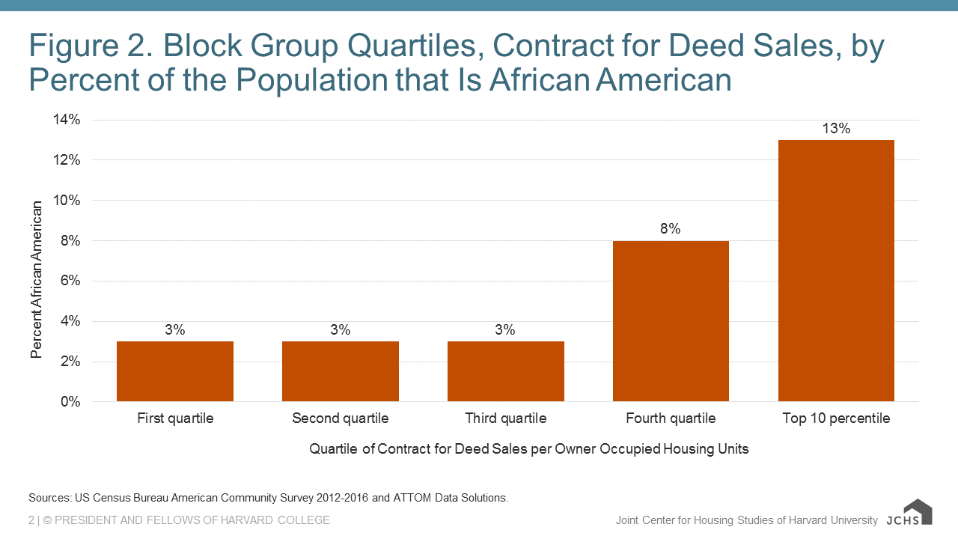
https://

Slide 17
The Cycle of discrimination
Redlining
Land contracts
Reverse redlining
Subprime boom
Foreclosure
Notes:
Much of the litigation in this space has involved the Fair Housing Act (and its state equivalent). What we have seen historically: Minorities (primarily African Americans) were denied access to loans through governmental redlining. As a result, many were forced to buy through abusive land contracts. During the subprime boom we saw reverse redlining, where these same populations were targeted for bad loans. There is now a substantial body of research that shows, even when income and credit scores were the same. African Americans were given high interest subprime loans. Many of these homes were foreclosed during the crisis, the homes sold to hedge funds and now those entities are offering predatory land contract.

Slide 18
Recent Federal Cases southern district of indiana
FHCI v. Marshall Welton et. al.
1:18-cv-01098
FHCI v. Rainbow Realty Group
1:17-cv-01782
Direct marketing to Hispanics
Rent with rent to own/land contracts/rent with option
Intentional discrimination
Case settled with a consent decree Nov 8: agreement to comply with federal law going forward and paying $395,000 in damages
Violation of several state and federal law, including Fair Housing
Rent to own (lease for 2 years that converts to land contract)
Pending
Notes:
I am aware of two cases currently involving Indiana homes (there may be more). The first involving Rainbow Realty is pending. The second, involving Marshall Welton and Casas Baratas settled on Nov 8. Both involved rent-to-buy schemes that targeted minority buyers with inflated sales prices, high interest rates, and properties that did not meet habitability standards.

Slide 19
Land Contracts and Eviction

Slide 20
Skendzel v. Marshall
301 N.E. 2d (Ind. 1973)
Land contract is a sale: an equitable mortgage
Breach requires a foreclosure
Forfeiture and eviction only if:
  Buyers has made minimal payments
  Buyer abandons
Notes:
Why did the sellers want to re-characterize these as rent-to-own? They were trying to get around this case. In 1973 our Supreme Court (in a decision that is consistent with most states) held that a land contract is a present sale. Sellers cannot simply go to small claims court to evict., unless the buyer has paid a minimal amount and abandons.
This was to avoid the inequitable result of having a buyer pay for 5 or 10 or even 15 years on a house and be evicted for one late payment, with a loss of all their payments. A foreclosure accounts for that equity.
With the lease option or rent-to-buy, the seller takes a large downpayment (or option) and then “rents “ the property to the buyer for a period of time, applying the rent payments to the purchase.

Slide 21

What is “less than minimal”
Must consider principal AND interest payments
  Looney v. Farmers Home Admin., 794 F.2d. 310 (7th. Cir. 1986)
  Morris v. Weigle, 270 Ind. 121,122, 383 N.E.2d 341, 342 (1978)
  Oles v. Plummer, 444 N,.E. ed 879,882 (Ind. App. 1983)

Slide 22
Some examples
    11,000 on 52,000 contract “more than minimal”
    Johnson v. Rutkoskey, 472 N.E.2d 620, 620(Ind. Ct. App. 9184)
“one third of the principal…certainly more than a ‘minimal amount’”
    Bartlett v. Wise, 169 Ind. App. 125, 348 N.E.2d 652, 654 (1976)

Slide 23
Cannot contract it away
Provisions attempting to set a minimal equity provision
Court said you cannot set this by contract
  Parker v. Camp, 656 N.E,.2d 882 (ind. Ct. App. 1995)

Slide 24
Depends on the “totality of the circumstances”
Johnson v. Rutkoskey, 472 N.E.2d 620, 626 (Ind. Ct. App. 9184)
Should consider “length of time and number of payments” McLemore v. McLemore, 827 N.E.ed 1135,1142 Ind. Ct. Ap. 2005)

Slide 25
McLemore v. McLemore, 827 N.E.2d 1135, 1142 (Ind. Ct. App. 2005)
“Even if only a minimal amount has been paid on a contract price, forfeiture is not appropriate unless the vendor’s security interest is jeopardized by the vendee’s acts or omissions.”

Slide 26

One last thing
One may not forfeit a contract and thereafter expect to enforce it” Powers v. Ford, 415 N.E.2d 734, 737 (Ind. Ct. App. 1981)

Slide 27
Other concerns
Failure to record the land contract
Summary eviction even after substantial payments
Burdens of ownership without the benefits
Most do not result in ownership
Prevents access to emergency disaster programs
Denial of homestead exemptions
Notes:
Land contracts, and most particularly the versions we see recently (rent to own, rent with options that are really land contracts) raise multiple other concerns:
Failure to record: many buyers do not know that they should record the land contract. The seller then either sells the contract or encumbers the property with a mortgage. They pay off the loan, only to find they cannot get title.
Summary eviction: neither parties or courts seem to understand that you cannot forfeit and evict when there is a land contract. You need to foreclose, just as if it were a mortgage
Buyers do all the maintenance and improvements that any home owner does, but they are unable to retain the benefits because most buyers never gain title to the property
When a crisis occurs (such as the recent Midwest floods, or a tornado or hurricane), the land contract buyer is not eligible for FEMA aid, only the record owner is. The record owner is rarely interested in applying for a loan to aid the buyer.
The land contract buyer is eligible for homestead credits, but only if the land contract is recorded and the owner cooperates

Slide 28
Enter the Investors
“eviction rates did not fall. to the contrary, landlords were encouraged to evict tenants after collecting those large option fees. and so, tenants who were not qualified to be buyers paid big bucks and signed “rent to own” contracts, on the promise of home ownership in the future. later, those tenants were evicted, and new tenants took their places, signed new lease-options, and paid more options fees. and, landlords laughed all the way to the bank.”
Lease-options & Land Contracts in Indiana: An essential Guidebook for Real Estate Investors and Landlords in Indiana, Griffith Law Group, 2014
“real estate investors started taking very large “down payments” from renters. investors went to “boot camps” and seminars, and were taught that large “down payments,” coupled with regular turnover of tenants, equated to a source of steady income of “option money,” much like monthly rent payments themselves.”
Notes:
Get-Rich seminars began appearing, telling people how to get rich with these products. This is party of an Indiana guide explaining the practice “ more and more national and regional real estate investment speakers began advocating lease-options for residential properties . books and tapes and cd-roms full of lease-option forms proliferated in number, and investors become [sic] very aggressive about how to structure lease-options. largely based on bad advice from these national and regional speakers, real estate investors started taking very large “down payments” from renters. investors went to “boot camps” and seminars, and were taught that large “down payments,” coupled with regular turnover of tenants, equated to a source of steady income of “option money,” much like monthly rent payments themselves. eviction rates did not fall. to the contrary, landlords were encouraged to evict tenants after collecting those large option fees. and so, tenants who were not qualified to be buyers paid big bucks and signed “rent to own” contracts, on the promise of home ownership in the future. later, those tenants were evicted, and new tenants took their places, signed new lease-options, and paid more options fees. and, landlords laughed all the way to the bank.”
Lease-options & Land Contracts in Indiana: An essential Guidebook for Real Estate Investors and Landlords in Indiana,
Griffith Law Group, 2014
The investors took the lessons to heart and began to try to characterize the “sales” not as sales but as either rentals with the option to purchase or as rent-to-own where you are renting for a defined period before the land contract began.
Lease-options & Land Contracts in Indiana: An essential Guidebook for Real Estate Investors and Landlords in Indiana, Griffith Law Group, 2014, http://www.indybizlaw.com/wp-content/uploads/RE-Lease-Options-Land-Contracts-e-Book.pdf

Slide 29
The Big Myth
Dodd Frank Wall Street Reform and Consumer Protection Act of 2010
Does nothing to preclude land contracts
Does set standards for high cost and higher cost loans

Slide 30
Rent with option to purchase
Way to “split” transaction to try to avoid TILA
Way to try to avoid both Skendzel and protections of Landlord Tenant law

Slide 31
“’rent-to-buy’ agreement is not a land-sale contract but a rental agreement subject to Indiana’s residential landlord-tenant statutes”
Rainbow Realty Group, Inc. v. Carter, 131 N.E.3d 168 (Ind. 2019)
Notes:
A recent Indiana supreme court cases affirmed what the statutes already said. If you rent a property, it must be in safe and habitable condition and it is the landlord, not the tenant, who is required to maintain the property.

Slide 32
In re Hanley, U.S. Bank Court, 111 Br. 709, 713 (CD Ill 1990) (citing to Greco v. Same, 336 F. Supp. (E.D. Mo, 1971)).
When evaluating whether TILA applies to a transaction, courts “look beyond the stated nature of a transaction to determine its true nature so as to prevent creditors from disguising the true nature of the transaction and thereby avoiding the impact” of the statute.

Slide 33

Is it a duck?
All the responsibilities of ownership, none of the benefits
All of the responsibilities of a tenant, none of the benefits
The option is impossible to exercise
An excessive NONREFUNDABLE DOWN PAYMENT IN ADDITION TO AN OPTION FEE
Payments applied to balance
Option payment separate from the down payment
Clear tenant protections
Defined term of the tenancy
No, or small, payment applied to balance
Owner pays taxes

Slide 34
Federal Law treats land contracts like mortgages
Truth in Lending
Home Owner Equity Protection Act
Real Estate settlement procedure act
Equal Credit Opportunity Act
Fair Housing Act
S.A.F.E. Act
Notes:
Federal law generally treats these as mortgages, at least for commercial sellers. This means that the seller must comply with Truth in Lending laws, specifically in regards to disclosing the terms, the Home Owner Equiry Protection Act, Equal Credit Opportunity Act, Fair Housing and the Safe Act.
I find that these are routinely violated, but especially the SAFe Act. Sellers do not realize that they must be licensed by the state.

Slide 35
When does T.I.L.A. apply
Regulation Z §1026.2
includes a “purchase money security interest under an installment sales contract.” 15 U.S.C. §1602(x);
If you regularly” extend credit
You regularly extend credit if you extend credit secured by a home, including by land contract, five times in the preceding calendar year.
if you are extending high-cost credit, you need only extend credit two times
If you use a broker, only one loan is required,
If you are subject to TILA under the later definition, than all your loans are subject to TILA, whether or not they too are high-cost.
.

Slide 36
TRUTH IN LENDING ISSUES 12 C.F.R. §226.18
Amount financed
A.P.R.
Total of payments
Payment amount and frequency
Finance charges

Slide 37
High Cost loans
If interest rate exceeds “by more than 6.5 percentage points…the average prime offer rate” at the time the interest rate was set. 15 U.S.C. §1602(bb)(1)(A)(i)(I)
Ex. Loan made July 25, 2016
  The average prime rate for a mortgage of comparable term on July 25, 2016 was 3.19 percent.
  Adding the trigger of 6.5% to the average prime rate of 3.19% gives you an interest rate of 9.69%.
  If the loan has an interest rate was higher than 9.69, it is a high cost loan

Slide 38
Requirements for high-cost loan
Ability to repay
Right of recession for refinances
Special notices
Pre-loan counseling
No financing of points and fees

Slide 39
HighER Priced Loan
A higher-priced mortgage is one in which the APR exceeds the average prime rate “as of the date the interest is set” by more than 1.5 percentage points. Reg. Z §1026.35
Ex. Loan made July 25, 2016
  The average prime rate for a mortgage of comparable term on July 25, 2016 was 3.19 percent.
  Adding the trigger of 1.5% to the average prime rate of 3.19% gives you an interest rate of 4.69%.
  If the loan has an interest rate was higher than 4.69, it is ahigher-priced mortgages.

Slide 40
Requirements of Higher-cost loans
analysis of whether the consumer has the ability to repay the loan.
establish an escrow account maintained in compliance with the Real Estate Settlement Procedures Act. 15 USC §1639d (f)
obtain an appraisal of the property and to provide a copy to the consumer

Slide 41
Indiana’s Home Loan Practices aCt
IC 24-9-3 et. seq.
Includes land contracts
Mirrors the federal protections
Adds deceptive practices

Slide 42

Prohibited Conduct
Divide a home loan transaction into separate parts with the intent of evading a provision of this article.
Structure a home loan transaction as an open-end loan with the intent of evading the provisions of this article if the home loan would be a high cost home loan if the home loan had been structured as a closed-end loan
Engage in, or solicit to engage in, a real estate transaction or a mortgage transaction without a permit or license required by law.

Slide 43
Deceptive Acts a violation
Engage in a deceptive act in connection with a mortgage transaction or a real estate transaction.

Slide 44

May not misrepresent
With respect to a real estate transaction or a mortgage transaction, represent that:
(A) the transaction has:
(i) certain terms or conditions; or
(ii) the sponsorship or approval of a particular person or entity;
that it does not have and that the person knows or reasonably should know it does not have;

Slide 45
Cannot misrepresent the property
property that is the subject of the transaction has any improvements, appurtenances, uses, characteristics, or associated benefits that it does not have and that the person knows or reasonably should know it does not have.

Slide 46
Requirements for escrow
MAY NOT :
  Maintain or offer to maintain an account for the receipt of funds for the payment of real estate taxes and insurance unless the person is any of the following:
  (A) Any of the following that is chartered under the laws of a state or the United States:
  (i) A bank.
  (ii) A savings and loan association.
  (iii) A credit union.
  (iv) A savings bank.
  (B) The creditor in a mortgage transaction.
  (C) A mortgage servicer acting on behalf of the creditor in a mortgage transaction.
  (D) A closing agent (as defined in IC 27-7-3.7-1).

Slide 47
MUST DISCLOSE ENCUMBERANCES
BY CERTIFIED MAIL:
(1) not later than the time the land contract is executed, if the encumbrance is created before or at the time the land contract is executed; or
(2) not later than ten (10) business days after the encumbrance is created, if the encumbrance is created after the land contract is executed.

Slide 48
Real Estate Settlement Procedures Act. Reg. Z §1026.35
Escrow account
Yearly statements
Restrictions on amount of the escrow:
  1/12 of the anticipated annual payments plus a small cushion “no greater than one-sixth” of the total 12 CFR 1024.17 (c) (ii.).

Slide 49
Summary
Land Contracts present numerous challenges
  Lack of habitability
  Chain of title (lack of recording)
  Inflated interest rates
  Inflated prices
  Common violation of Federal Statutes
  Loss of Equity

